Slide 1
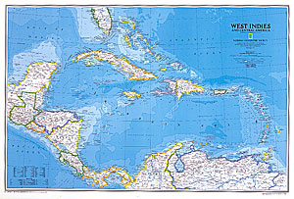
Hurricane Season 2008
Impacts on Jamaica

Slide 2
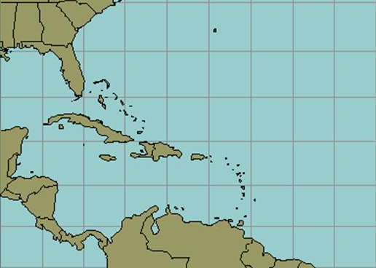
TROPICAL CYCLONE NAMES 2008
ARTHUR
BERTHA
CRISTOBAL
DOLLY
EDOUARD
FAY
GUSTAV
HANNA
IKE
JOSEPHINE
KYLE
LAURA
MARCO
NANA
OMAR
PALOMA
RENE
SALLY
TEDDY
VICKY
WILFRED

Slide 4
T.S. FAY near Jamaica

Slide 7
TROPICAL CYCLONE NAMES 2008
ARTHUR
BERTHA
CRISTOBAL
DOLLY
EDOUARD
FAY
GUSTAV
HANNA
IKE
JOSEPHINE
KYLE
LAURA
MARCO
NANA
OMAR
PALOMA
RENE
SALLY
TEDDY
VICKY
WILFRED

Slide 10
T.S. GUSTAV approaching

Slide 11
T.S. GUSTAV over Haiti

Slide 12
T.S. GUSTAV stalls and relocates

Slide 13
T.S. GUSTAV at the coast

Slide 14
T.S. GUSTAV over Jamaica

Slide 15
T.S. GUSTAV moves away

Slide 17
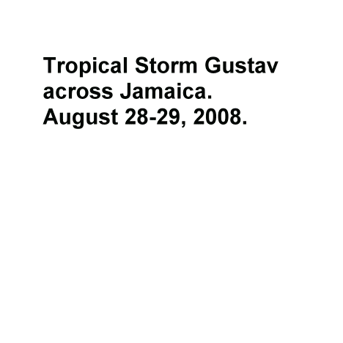

Slide 18
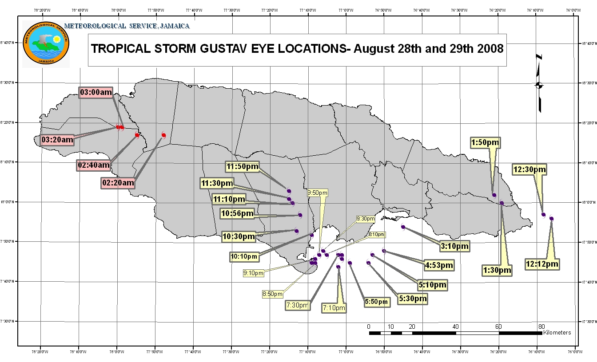

Slide 19
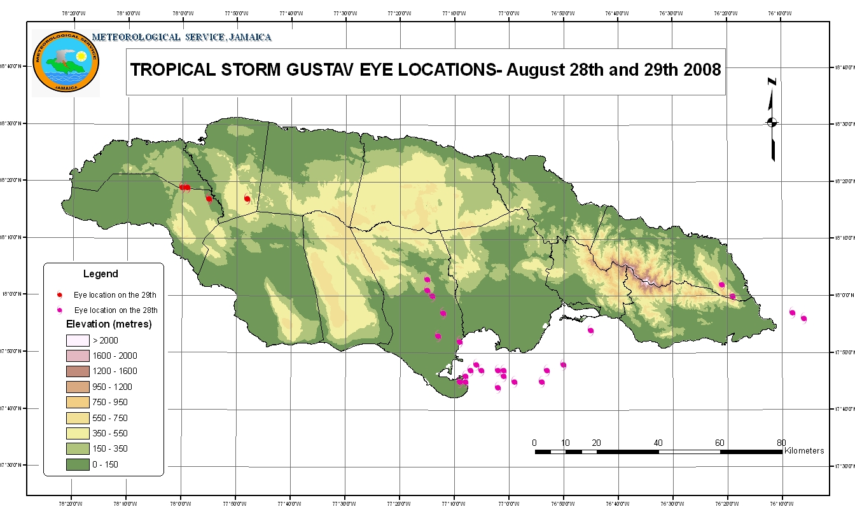

Slide 20
Damage to Bridge Network

Slide 21
Damage to Bridge Network

Slide 22
Loss of Housing Stock

Slide 23
Loss of Housing Stock

Slide 24
Loss of Housing Stock

Slide 25
Loss of Housing Stock

Slide 26
Damage to Banana Industry

Slide 27
Damage to Road Network

Slide 30
TROPICAL CYCLONE NAMES 2008
ARTHUR
BERTHA
CRISTOBAL
DOLLY
EDOUARD
FAY
GUSTAV
HANNA
IKE
JOSEPHINE
KYLE
LAURA
MARCO
NANA
OMAR
PALOMA
RENE
SALLY
TEDDY
VICKY
WILFRED

Slide 32
HURRICANE IKE over Cuba

Slide 35
TROPICAL CYCLONE NAMES 2008
ARTHUR
BERTHA
CRISTOBAL
DOLLY
EDOUARD
FAY
GUSTAV
HANNA
IKE
JOSEPHINE
KYLE
LAURA
MARCO
NANA
OMAR
PALOMA
RENE
SALLY
TEDDY
VICKY
WILFRED

Slide 37
Radar Loop of HURRICANE PALOMA

